Slide 1
Poetry and Visual Analysis
By Jacinta Auchinleck

Slide 2
Poem #1: Hello by Adele
Hello, it's me I was wondering if after all these years you'd like to meet To go over everything They say that time's supposed to heal ya, but I ain't done much healing Hello, can you hear me? I'm in California dreaming about who we used to be When we were younger and free I've forgotten how it felt before the world fell at our feet There's such a difference between us And a million miles Hello from the other side I must've called a thousand times To tell you I'm sorry for everything that I've done But when I call you never seem to be home Hello from the outside At least I can say that I've tried To tell you I'm sorry for breaking your heart But it don't matter, it clearly doesn't tear you apart Anymore Hello, how are you? It's so typical of me to talk about myself, I'm sorry I hope that you're well Did you ever make it out of that town where nothing ever happened? It's no secret that the both of us Are running out of time

Slide 3
Poem text continued…
So hello from the other side I must've called a thousand times To tell you I'm sorry for everything that I've done But when I call you never seem to be home Hello from the outside At least I can say that I've tried To tell you I'm sorry for breaking your heart But it don't matter, it clearly doesn't tear you apart Hello from the other side I must've called a thousand times To tell you I'm sorry for everything that I've done But when I call you never seem to be home Hello from the outside At least I can say that I've tried To tell you I'm sorry for breaking your heart But it don't matter, it clearly doesn't tear you apart Anymore

Slide 4
Poem #1: Analysis
Poem Type: Ballad
Poetic Element #1:
One of the key poetic elements in this poem is the use of apostrophe. Throughout the text, the speaker is calling out to their long lost love trying to apologize for the wrongs she has done in their past relationship. She says that she called “to tell [him she’s] sorry for breaking his heart”. Sadly, he does not respond as shown in the line “when I call you you never seem to be home.” It is obvious that he is avoiding her calls, and as such this use of apostrophe creates a very haunting impression on the audience.
Poetic Element #2:
Another key poetic element used in this poem is metaphor. This is shown in the line “when the world fell at our feet”. Here, Adele is using figurative language to show how, as the relationship broke apart, it seemed as if the world as she knew it fell apart as well.

Slide 5
Poem #1: Analysis continued…
Mood:
The mood created in this poem can be considered desolate or melancholic. Throughout the poem there is a sense of dismal emptiness and regret experienced by the speaker to which the audience responds. The audience can not help but feel a sense of melancholy towards the speaker’s situation, especially when she comments that “she hasn’t done much healing”, even though time has passed. She appears broken hearted, and this is made worse by the fact that she doesn’t get to actually “tell you [him] I’m sorry” for having hurt the other individual.

Slide 6
Poem #1: Analysis
Effective Imagery:
One image from the poem that is particularly effective in this poem is when it states, “there’s such a difference between us/and a million miles”. This image uses a hyperbole to exaggerate the distance between the ex-lovers. The audience knows that there can not logically be a “million miles” between the lovers, but it acts as a symbol to reveal how disconnected their relationship has become. The audience can visually picture what a great distance a million miles actually is, and as such not only their physical distance, but emotional distance is emphasized. This symbol additionally contributes to why the mood becomes so melancholic for the audience because one begins to feel sympathetic towards her situation.

Slide 7
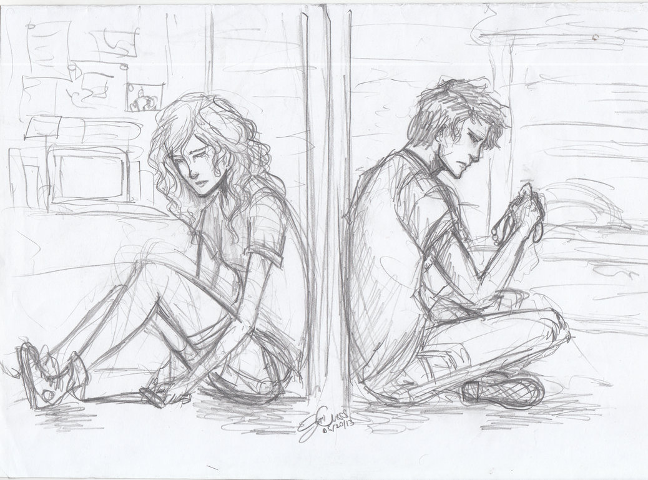
Visual #1: Analysis

Slide 8
Type of Visual: Sketched Drawing
Visual Element #1:
One key visual element used in this visual is balance. Here, balance is shown as the female and male are positioned so that each figure takes up approximately one half of the visual. They both have their back to the wall separating them, and by creating this balance, the artist is able to show the audience how they are equally feeling the pain in their relationship.
Visual Element #2:
A second visual element used in this visual is line. Due to their sloped/arched shoulders and their hanging heads these figures appear to be weighted down by some emotional stress that has been caused in their relationship.

Slide 9
Visual #1: Analysis
Suggested Title: “Suffering in Silence”
An appropriate title for this visual is “Suffering in Silence”. This title is fitting because both of the figures are isolated on their respective sides of the wall, and they are obviously not engaging with each other, or with anyone else for that matter in order to share their pain. This title is also deemed appropriate because of their forlorn facial expressions (i.e. frowning) and their burdened/heavy body language (i.e. slouched with heads hung low).

Slide 10
Poem and Visual #1: Thematic Link
The poem and the visual share the theme that a lack of communication dooms all relationships. In the poem “Hello”, the speaker has evidently lost touch with her ex-lover, and instead of fixing their problems at the start, their lack of communication has caused a major rift between the two that can not be undone. It appears as if he is ignoring her calls where she attempts to say, “I’m sorry for everything that I’ve [the speaker] done”, and she never gets the closure that she seems to so desperately be seeking. Even though she has called “a thousand times”, without her ex-lover opening up the lines of communication, nothing can be resolved. This same idea is evident in the visual as neither of the figures appears to be making any effort to open the lines of communication with the other. There is a large wall separating the two of them, and neither of them are trying to open the lines of communication with any electronic device (i.e. computer or cell phone). They are wallowing in their pain, and neither individual is attempting make the effort which would allow them to start to heal. As a result, the theme that a lack of communication dooms all relationships effectively links both the poem and visual.

